Slide 1

DEFENCE R&D ORGANISATION
CHANDIPUR, BALASORE
REPORT ON : Implementation of PXE LAN webpage
Team Members:
Guided By:
Ankit Pradhan
Kanishka Dhada
Narayan Sharma
Meghna Rani Dasbabu
Mr. Pranab Ghosh ( Sc. F)
Sri. Suman Mondal (Sc. C)

Slide 2
Table of Content
Introduction
Objective
Tools used

Slide 3
Introduction
A website is a collection of many web pages, and web pages are digital files that are written using HTML(Hyper Text Markup Language). The website’s web pages are linked with hyperlinks and hypertext and share a common interface and design. The website might also contain some additional documents and files such as images, videos, or other digital assets.
Front-end web development, also known as client-side development is the practice of producing HTML, CSS and JavaScript for a website or Web Application so that a user can see and interact with them directly.

Slide 4
Objective
Tools used
The objective of designing this website is to ensure that when the users open up the site they see the information in a format that is easy to read and relevant.
HTML
CSS
JAVASCRIPT
BOOTSTRAP 5
Visual studio

Slide 5
Summary
We worked on the fronted development of the PXE website.
We learned the fundamentals of web development and gained various insights regarding web development.
While working on frontend we faced some errors like it wasn’t responsive
We worked on these errors and debugged them.

Slide 6
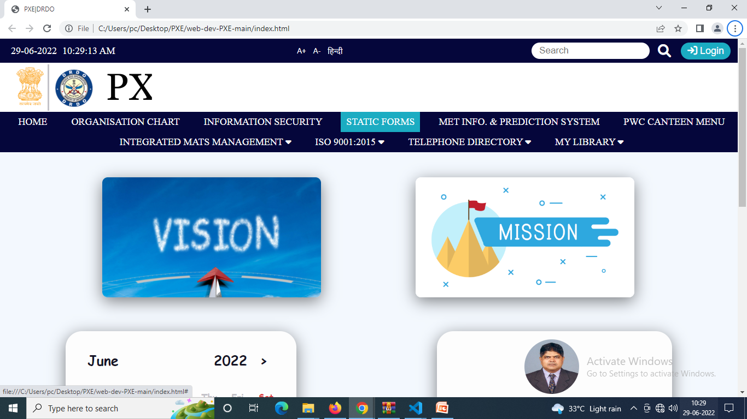
OUTPUT

Slide 7
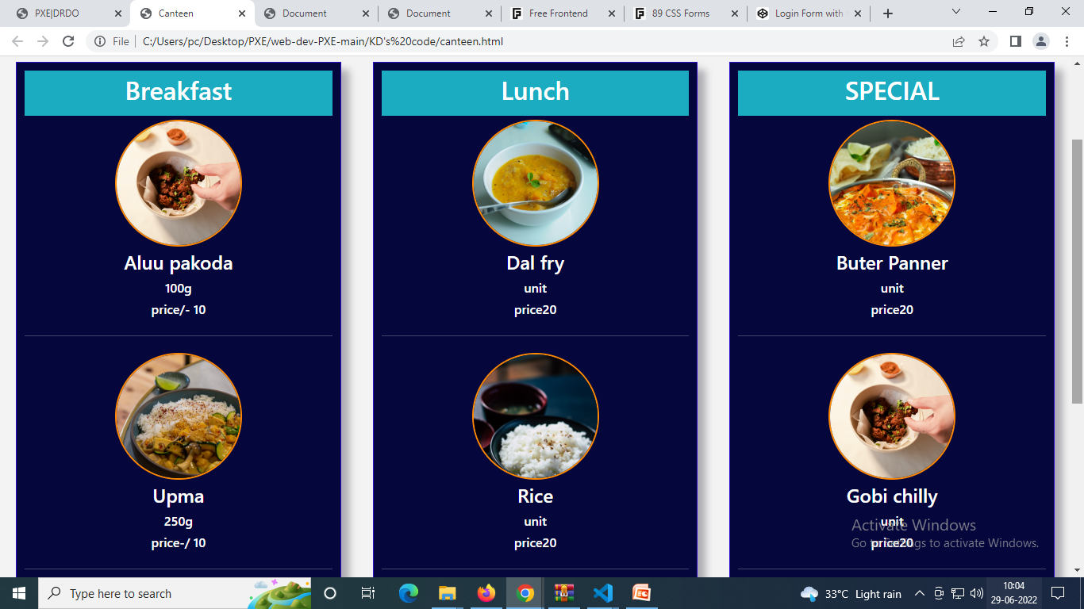
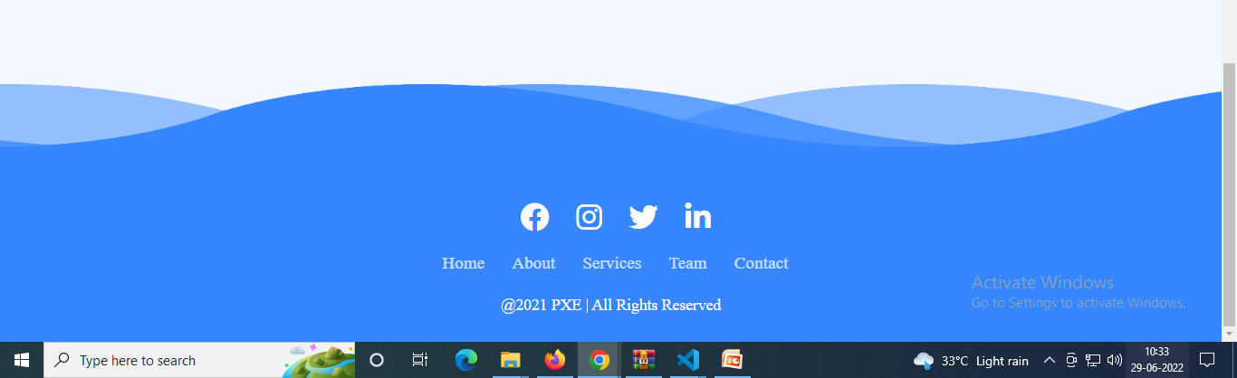

Slide 8
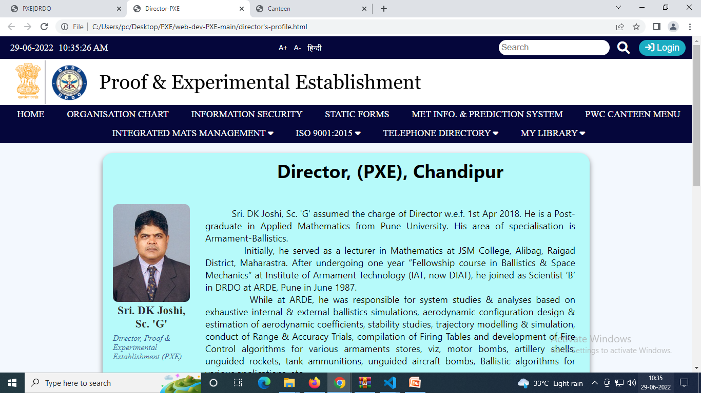

Slide 9
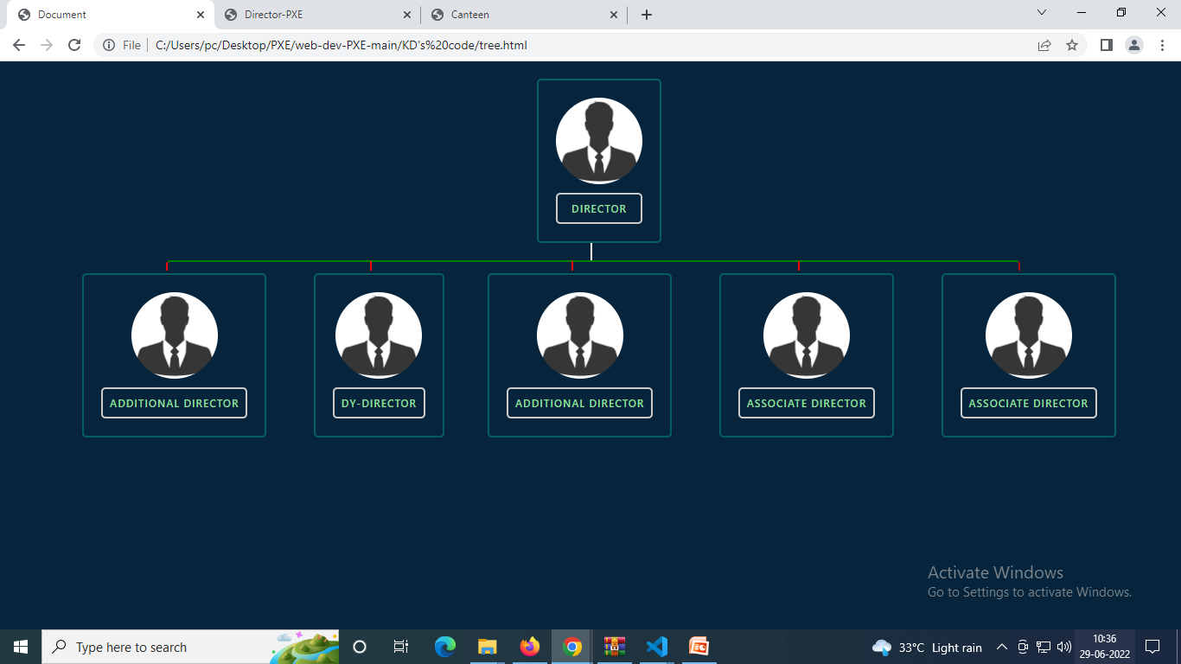

Slide 10
THANK YOU

